Slide 1
Ensemble Models
Varol Kayhan, PhD

Slide 2
Agenda
Classifiers
Ensemble models
Voting classifier
Bagging
Random Forest
Boosting algorithms
Regressors

Slide 3

Wisdom of Crowds
Asking a question to a crowd
Aggregate the answers

Slide 4
Ensemble Models
Use the results of a bunch of models
Random Forest approach:
Training set
Dec.Tree 1
Predicted="1"
Dec.Tree 2
Dec.Tree 3
Predicted="0"
Predicted="1"
One possible reconciliation: Use "voting" (i.e., simple majority)
Predicted="1"

Slide 5
Ensemble Models
Even if each model is "weak", the ensemble can be very accurate!
Be careful: models should be sufficiently diverse!
How to build diverse models?
1) Use different algorithms (so they make different errors)
2) Use the same algorithm on different random training subsets

Slide 6
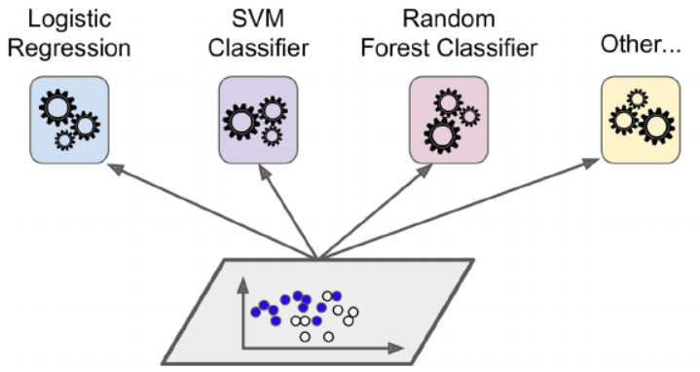
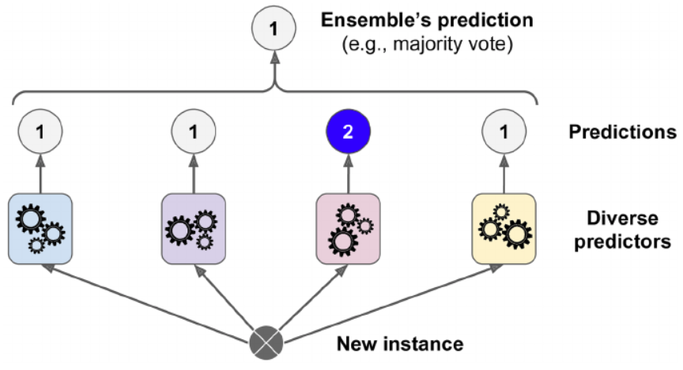
Voting Classifier
Use different algorithms
Aggregate the predictions using “voting”

Slide 7
Voting Classifier
Hard vs. Soft voting
Soft voting
(highest average probability*)
Hard voting
(simple majority)
Prob=0.52
Prob=0.54
Prob=0.60
Prob=0.58
Prediction = 1
Prob 1 = 0.5467
Prob 2 = 0.60
Prediction = 2
* Make sure each classifier has the predict_proba() method

Slide 8
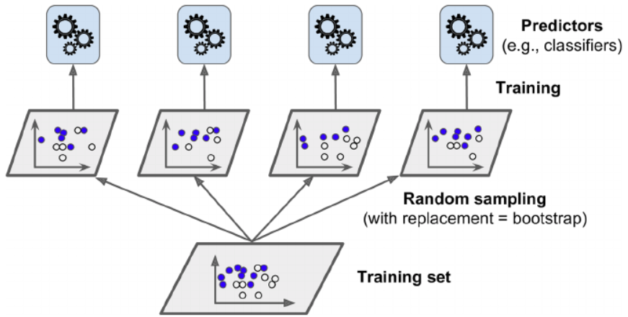
Bagging
Use the same predictor (e.g. decision tree)
Bagging: use different random subsets WITH replacement
Short for "bootstrap aggregating"
Pasting: use subsets WITHOUT replacement
Final prediction is hard voting, but soft voting is also possible.

Slide 9
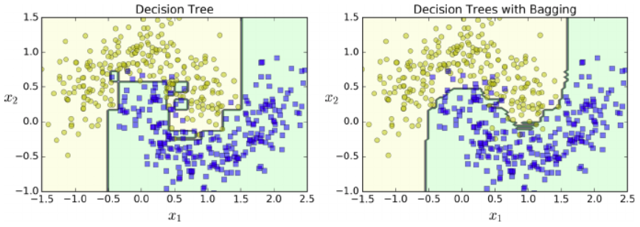
Bagging
500 trees

Slide 10
Out-of-Bag Evaluation
Bagging samples nearly 63% of training set per predictor (model)
Remaining 37% is called "out-of-bag" (OOB)
Be careful: the 37% is different for each predictor
Use the 37% for validation (instead of a separate validation set)
Ensemble evaluation = Average of the OOB performance

Slide 11
Random Patches and Random Subspaces
Random Patches:
Sample from the training instances
Sample from the training features (i.e., inputs)
Random Subspaces:
Keep all training instances
Sample from the features
(There are SciKit APIs to do both)

Slide 12
Random Forests
The same as using a decision tree with "bagging"
Can do both classification and regression
RandomForestClassifier()
RandomForestRegressor()
Two sets of hyperparameters:
Decision tree (e.g., max_depth)
Ensemble (e.g., n_estimators (number of decision trees))
Considers a random subset of features at each split
(Introduces extra randomness)

Slide 13
Extra-Trees
"Extremely Randomized Trees"
Add further randomness:
Splitting rules are not based on reduction in most impurity
Rather, splitting rules are randomly selected
Trains much faster

Slide 14
Feature Importance
Random forests provide feature importance
How much does a feature reduce impurity compared to others?
Since there are many trees, this is a weighted average!
If a feature is not used in any tree, it has 0 importance

Slide 15
Boosting
Refers to converting weak learners to a strong one (using ensemble)
Trains predictors sequentially (as opposed to simultaneously)
Each predictor corrects the predecessor
Two types:
Adaptive boosting (AdaBoost)
Gradient boosting

Slide 16
AdaBoost
Can be used for:
Classification (AdaBoostClassifier)
Regression (AdaBoostRegressor)
Works with “instance weights” in both cases

Slide 17
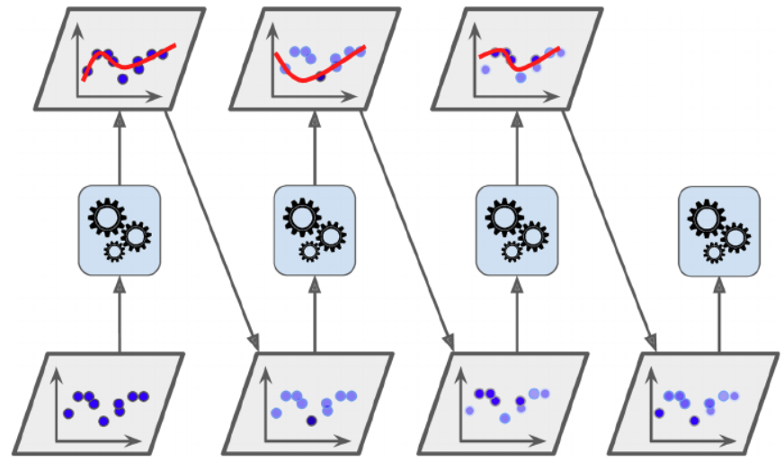
AdaBoostClassifier
Each subsequent predictor focuses on "underfitted" instances in the predecessor
For classification:
Train
Identify misclassified instances
Increase their relative weights
Train a new model
Repeat 2-4
Stop: if max_number is reached, OR perfect model is achieved.
Use the same training data set (with adjusted weights)

Slide 18
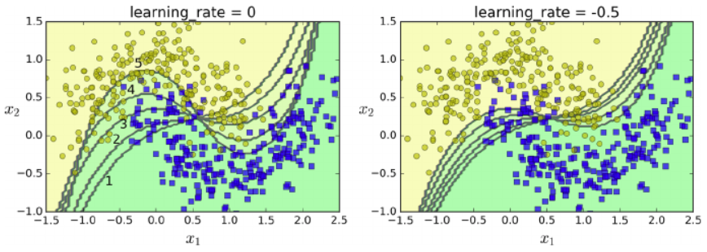
AdaBoostClassifier
Example: SVM with RBF Kernel, 5 predictors

Slide 19
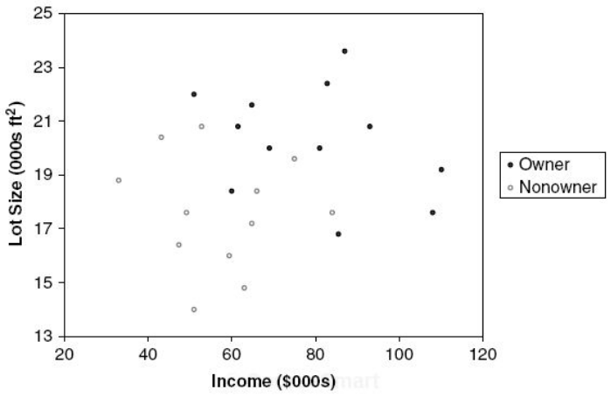
AdaBoostClassifier
Works best with “weak learners”
Decision stump: a decision tree with only 1 level
Owners: 12
Non-owners: 12
Lot size
≤19
>19
Owners: 3
Non-owners: 9
Owners: 9
Non-owners: 3

Slide 20
AdaBoostClassifier
What are “instance weights”?
In the beginning, each instance has a weight of 1/n
After training, weights of misclassified instances are “boosted”
These weights determine how to do the split in the decision stump

Slide 21
AdaBoostClassifier
What are “predictor weights”?
Each model has a different weight “α” (based on its accuracy on weighted training set)
The higher the accuracy, the higher the weight
Predictions:
Each model makes a prediction
Calculate weighted predictions using α’s
Find the majority of weighted predictions
α₁
α₂
α₃

Slide 22
AdaBoostClassifier
Scikit uses SAMME (Stagewise Additive Modeling using a Multiclass Exponential loss function)
Multiclass version of AdaBoost
If two classes, then the same as Adaboost
If the algorithm has predict_proba() method:
SciKit can use SAMME.R
R = Real
Generally performs better than SAMME

Slide 23
Gradient Boosting
Can be used for:
Classification (GradientBoostingClassifier)
Regression (GradientBoostingRegressor)
Similar to AdaBoost but does not weigh instances!
Instead: Fits the new predictor to the “residual error” made by previous predictor
(y_{actual} – y_{predicted})

Slide 24
Gradient Boosting
Uses decision trees
Also called Gradient Boosting Trees

Slide 25
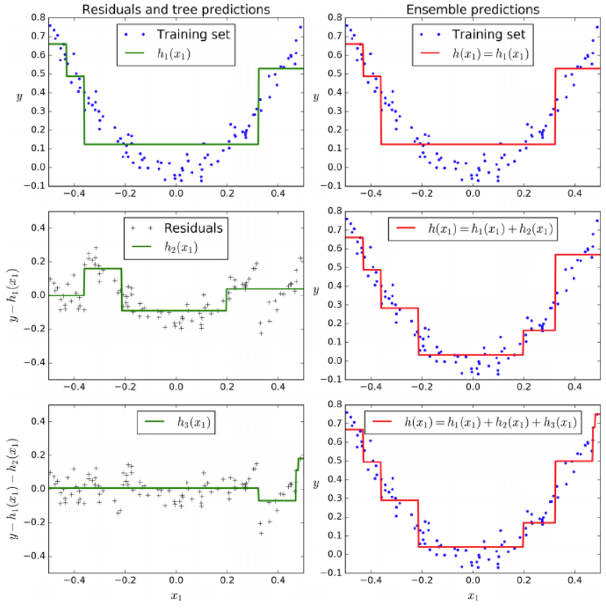
GradientBoostingRegressor

Slide 26
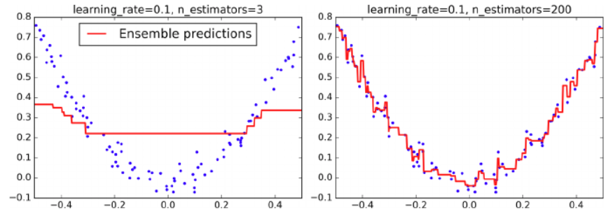
GradientBoostingRegressor
Learning rate:
If set low, you need more trees.
Better generalization
This is called “shrinkage”
Underfitting
Overfitting
Use "early stopping" to avoid overfitting
(i.e., stop when validation error dips)

Slide 27
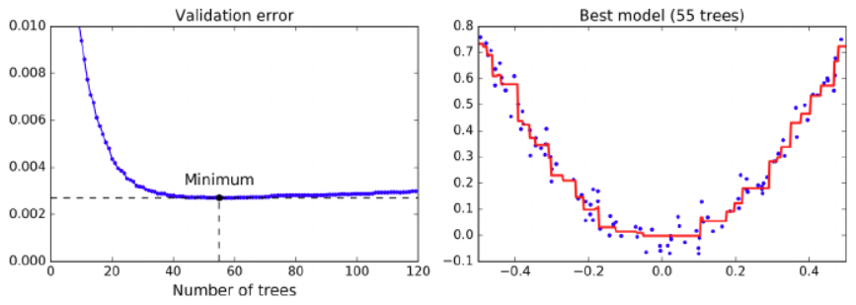
Early stopping

Slide 28
Stochastic Gradient Boosting
Performed using the "subsample" hyperparameter
E.g., train each tree on randomly selected 25% of data

Slide 29
What about Regression tasks?
All ensemble models also have a regressor
In this case, the average of all individual regressor is the final prediction

Slide 30
Voting Regressor
Simple average
Training set
Dec.Tree Reg
Predicted="$200"
SGD Reg
SVM Reg
Predicted="$150"
Predicted="$160"
Take the simple average
Predicted="$170"

Slide 31
Voting Regressor
Weighted average
Training set
Dec.Tree Reg
Predicted="$200"
SGD Reg
SVM Reg
Predicted="$150"
Predicted="$160"
w=0.3
w=0.6
w=0.1
Take the weighted average
Predicted=0.3x200 + 0.6x150 + 0.1*160
= 166

Slide 32
Other Ensemble Models…
Same idea: take the average of individual regressors

Slide 33
Ensemble Models
What is the advantage of ensemble models?
What is the disadvantage of ensemble models?

Slide 34
Summary
Classifiers
Ensemble models
Voting classifier
Bagging
Random Forest
Boosting algorithms
Regressors

